Slide 1

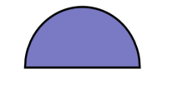

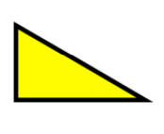
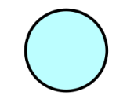
Subtopic N2.9 – Perimeter of Irregular Polygons
LEARNING OUTCOME: to solve problems involving the perimeter of polygons
Keywords:
Distance
Polygon
Edges
Length
Units
Sum
Objectives:
To recognise a polygon
To find the perimeter of a polygon
To find missing lengths in a polygon
Introduction – Read and annotate:
To find the perimeter of an irregular polygon, add the lengths of all its sides, even if they are
different. Unlike regular polygons, irregular polygons do not have equal sides, so each side must be
measured or given before calculating the total distance around the shape.
Definition
Characteristics
A closed 2D shape where all edges are straight lines
Polygons have properties based on the number of sides they have
Examples
Polygon
Non - Examples
Characteristics
Definition
If we know the lengths of the sides of a 2D shape, we can find the perimeter by adding up the sides
The distance all the way around the outside of a 2D shape.
Examples
Perimeter
Non - Examples
7cm
4cm
6cm
At this stage, we will only find
perimeters for shapes with straight line edges
Perimeter = 4cm + 6cm + 7cm = 17cm
Identify irregular polygons
Example 1 - I do…
Example 2 – We do…
Example 3 – You do…
Steps | Tick the polygon: | Tick the polygon: | Tick the polygon:
1. Check whether all the sides are straight and if it is closed
Independent Practice
Tick the shapes that are polygons.
2. Complete the sentence:
A polygon is a _closed_ shape with _straight_ edges.

Slide 2
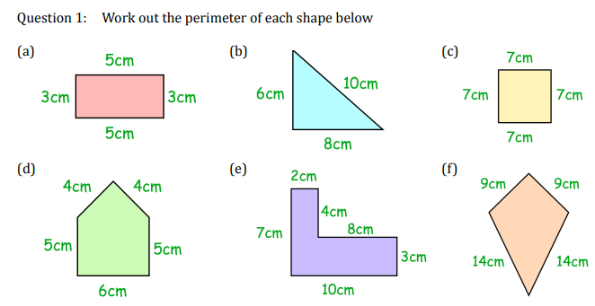
Find the perimeter of a polygon
Example 4 - I do…
Example 5 – We do…
Example 6 – You do…
Steps | Find the perimeter of this shape: | Find the perimeter of this shape: | Find the perimeter of this shape:
1. Add together all the side lengths
2. Include units with your answer
8 cm
7.2 m
7.4 cm
1 cm
4 cm
6 cm
6.1 m
6 cm
5.2 cm
7 cm
9.34 m
8 cm
25cm
22.64m
27.6cm
Independent Practice
Independent Practice
Find the perimeter of each shape below
16cm
24cm
28cm
24cm
34cm
46cm
4. Find the perimeter of each shape below
a)
4.8 cm
b)
2.3 cm
2.3 cm
0.31 m
0.26 m
4.8 cm
0.7 m
14.2cm
1.27cm
c)
8.8 cm
d)
90 cm
6.1 cm
67 cm
67 cm
13 cm
7.5 cm
0.3 m
0.3 m
14.8 cm
50.2cm
1.03 m
1.03 m
490cm = 4.9m

Slide 3
Find a missing side length in a polygon
Example 7 - I do…
Example 8 – We do…
Example 9 – You do…
Steps | Find the missing length: | Find the missing length: | Find the missing length:
1. Add together the known side lengths
2. Subtract this total from the perimeter
Perimeter = 27 cm
Perimeter = 19 m
Perimeter = 8.3 m
9 cm
8.2 m
?
5 cm
?
?
1.7 m
9.3 m
4.4 m
7 cm
6cm
1.5m
2.2m
Independent Practice
5. Find the missing length for each shape below, given their perimeters
a) Perimeter = 56 cm b) Perimeter =404 m
c) Perimeter = 28.4 cm d) Perimeter = 300 m
e) Perimeter = 54 cm f) Perimeter = 20.4 m
6. An animal enclosure is made up of four pieces of fencing.
Two pieces are 5.3 m long. One piece is 6.7 m long.
The perimeter of the enclosure is 22 m.
What is the length of the final piece of fencing?
24 cm
17 cm
50 m
48 m
? cm
135 m
? m
15m
103 m
68m
8.7 cm
? cm
? m
48 m
58.2 m
10.2 cm
90 m
9.5cm
103.8m
? cm
9.5 cm
9.5 cm
870 cm
4.8 cm
4.8 cm
? cm
12.3 cm
12.3 cm
0.8cm
908 cm
2.62m = 262cm
4.7m

Slide 4
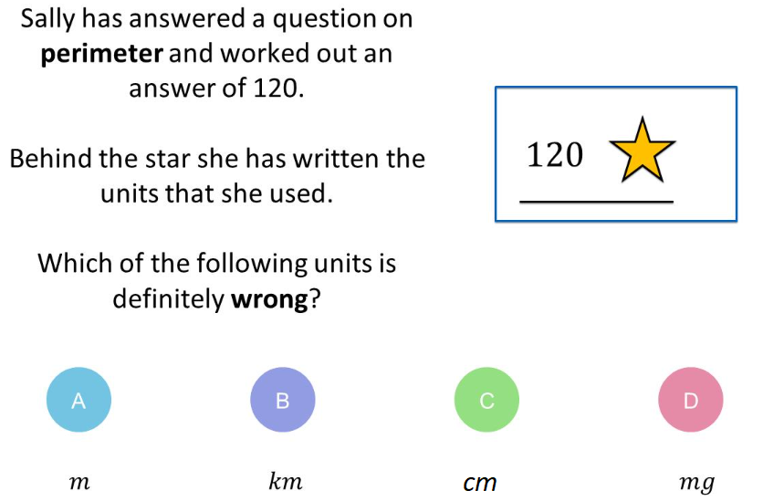
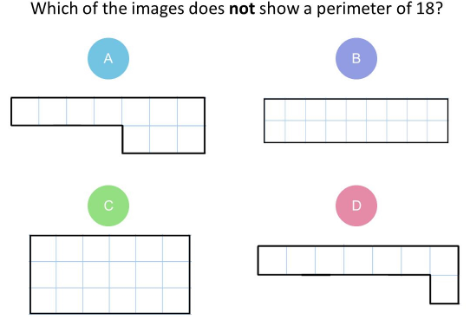
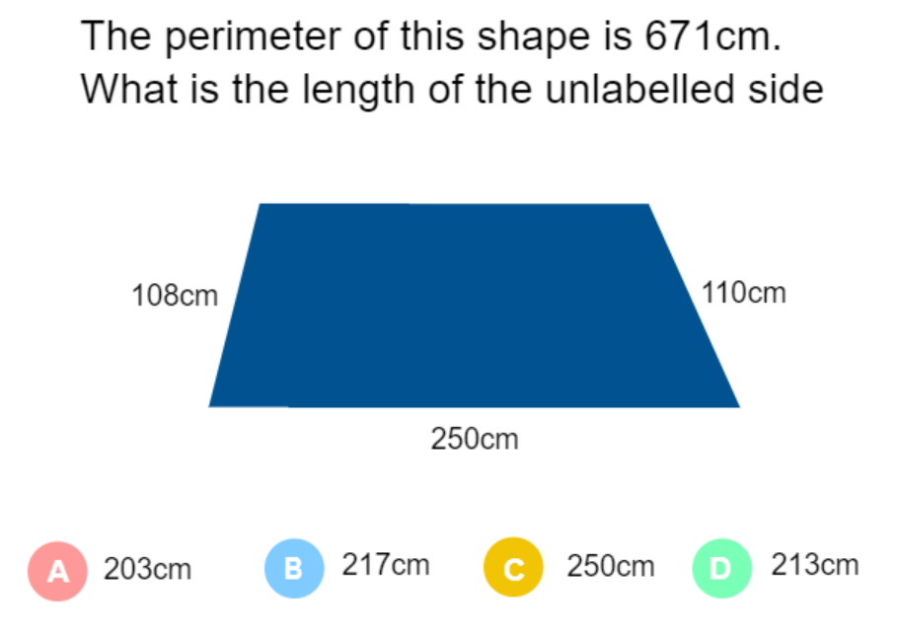
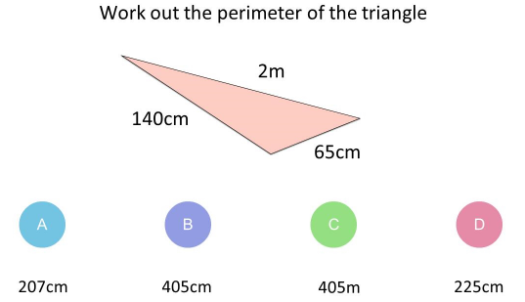

Skills Check
1. 2.
3. 4.
200cm

